Slide 1
Numerical Computation and Optimization
Solution of Linear Algebraic Equations
Gaussian Elimination
NAIVE GAUSS ELIMINATION
By
Assist Prof. Dr. Ahmed Jabbar

Slide 2
Gaussian Elimination and Back Substitution
The basic idea behind methods for solving a system of linear equations is to reduce them to linear equations involving a single unknown, because such equations are trivial to solve. Such a reduction is achieved by manipulating the equations in the system in such a way that the solution does not change, but unknowns are eliminated from selected equations until, finally, we obtain an equation involving only a single unknown. These manipulations are called elementary row operations, and they are defined as follows:
Multiplying both sides of an equation by a scalar
Reordering the equations by interchanging both sides of the i_{th} and j_{th} equation in the system
Replacing equation i by the sum of equation i and a multiple of both sides of equation j
The third operation is by far the most useful. We will now demonstrate how it can be used to reduce a system of equations to a form in which it can easily be solved.

Slide 4
Note that the number of steps of forward elimination is (n-1)
In case of three equations
# steps =(n-1)=(3-1)= 2 steps

Slide 6
x₁

Slide 7
PITFALLS OF ELIMINATION METHODS
Division by Zero
Round-Off Errors
Ill-Conditioned Systems

Slide 8
Divide by Zero ☹

Slide 9
Round-Off Errors ☹

Slide 10
Ill-Conditioned Systems
ill-conditioned system is one with a determinant close to zero

Slide 11
Techniques For Improving
Solutions

Slide 15
Use of More Significant Figures
The simplest remedy for ill-conditioning is to use more significant figures in the computation.
If your application can be extended to handle larger word size, such a feature will greatly reduce the problem. However, a price must be paid in the form of the computational and memory overhead connected with using extended precision.

Slide 16
Pivoting
The Problem
obvious problems occur when a pivot element is zero because the normalization step leads to division by zero. Problems may also arise when the pivot element is close to, rather than exactly equal to, zero because if the magnitude of the pivot element is small compared to the other elements, then round-off errors can be introduced.

Slide 17
Pivoting
Possible solution
Therefore, before each row is normalized, it is advantageous to determine the largest available coefficient in the column below the pivot element. The rows can then be switched so that the largest element is the pivot element. This is called partial pivoting.
If columns as well as rows are searched for the largest element and then switched, the procedure is called complete pivoting. Complete pivoting is rarely used because switching columns changes the order of the x’s and, consequently, adds significant and usually unjustified complexity to the computer program.

Slide 18
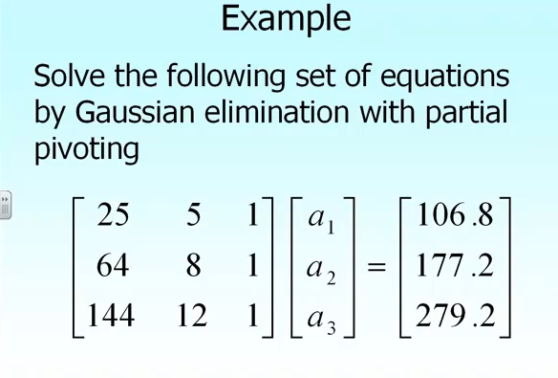

Slide 19
Forward Elimination

Slide 20
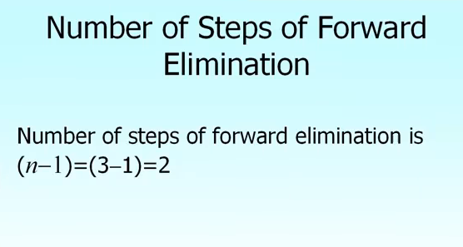

Slide 21
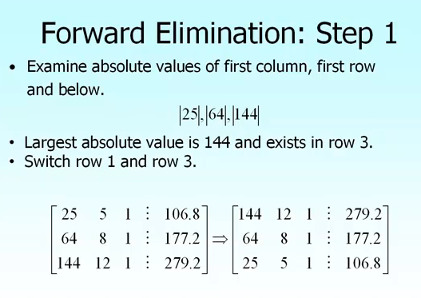

Slide 22
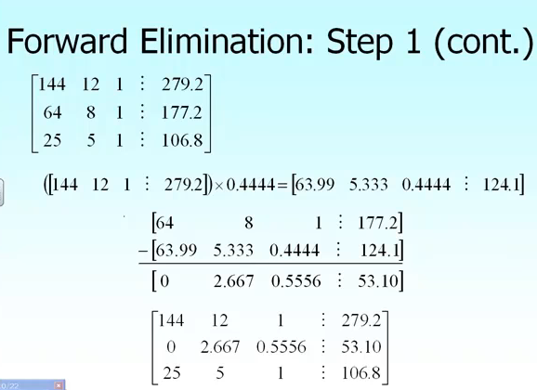

Slide 23
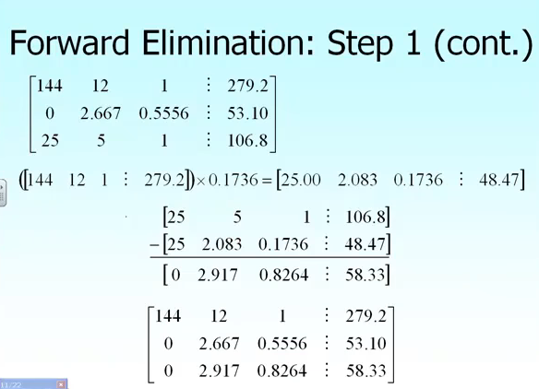

Slide 24
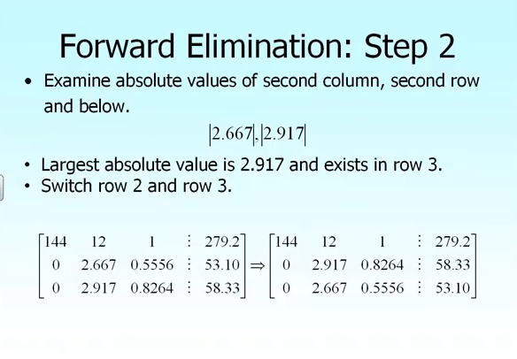

Slide 25
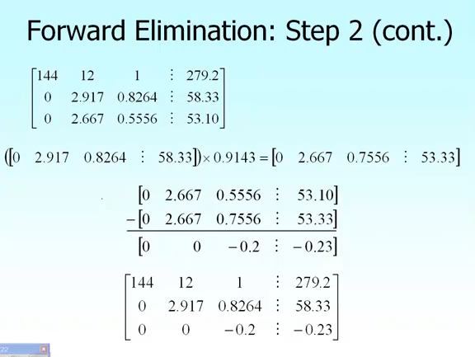

Slide 26
Back substitution

Slide 27
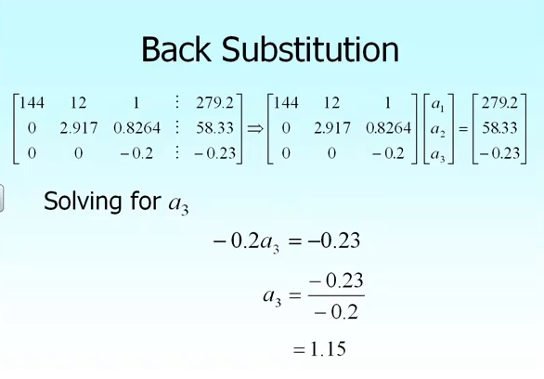

Slide 28
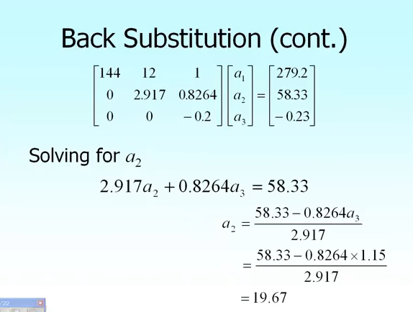

Slide 29
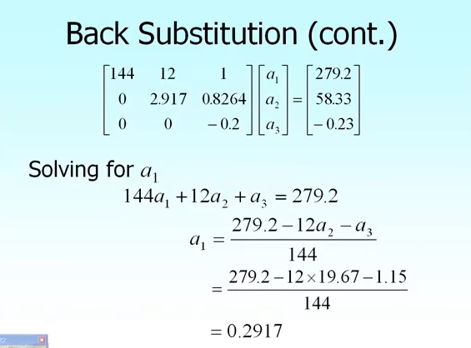

Slide 30
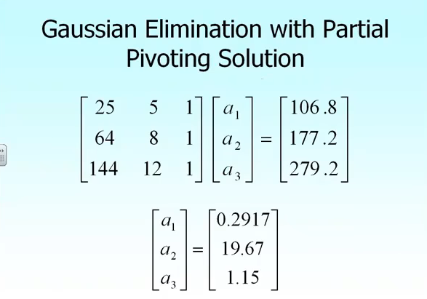

Slide 31

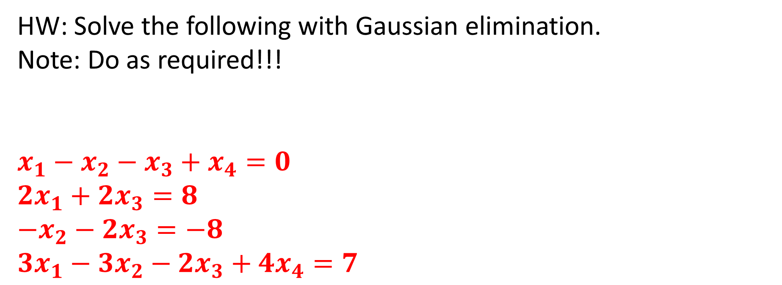
HW: Solve the following with Gaussian elimination.
Note: Do as required!!!
$$x_{1}−x_{2}−x_{3}+x_{4}=0$$
$${2x}_{1}+2x_{3}=8$$
$$−x_{2}−{2x}_{3}=−8$$
$$3x_{1}−3x_{2}−{2x}_{3}+4x_{4}=7$$

