Slide 1
Numerical Computation and Optimization
Solution of Nonlinear Equations
Open Methods
Fixed Point Iteration
By
Assist Prof. Dr. Ahmed Jabbar

Slide 3
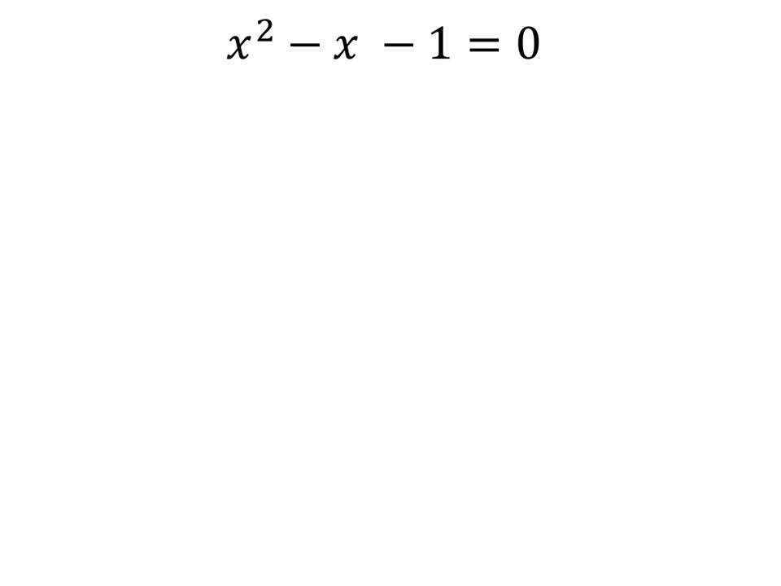

Slide 4
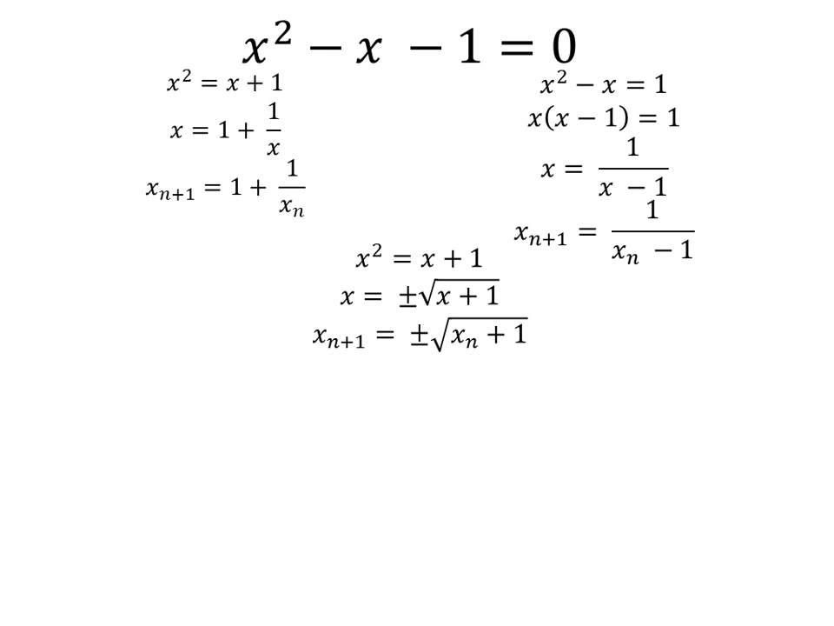

Slide 5
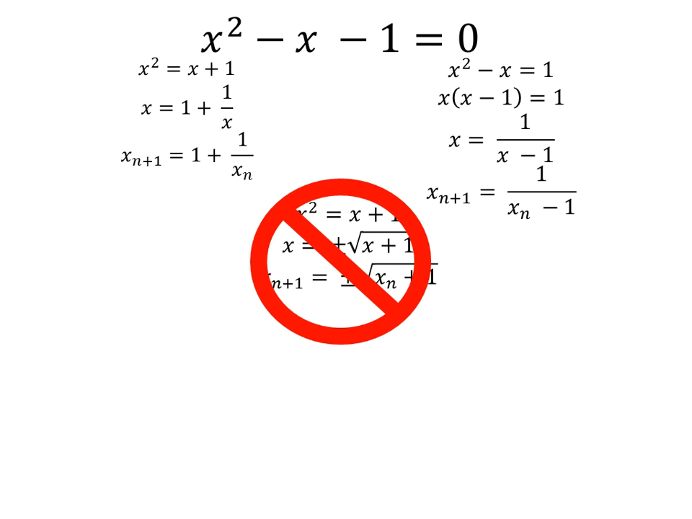

Slide 12
Summery
Notice that the true percent relative error for each iteration of the example is roughly proportional (for this case, by a factor of about 0.5 to 0.6) to the error from the previous iteration.
This property, called linear convergence, is characteristic of fixed-point iteration

