Slide 1
Numerical Computation and Optimization
Solution of Nonlinear Equations
Open Methods
Newton’s Method
By
Assist Prof. Dr. Ahmed Jabbar

Slide 2
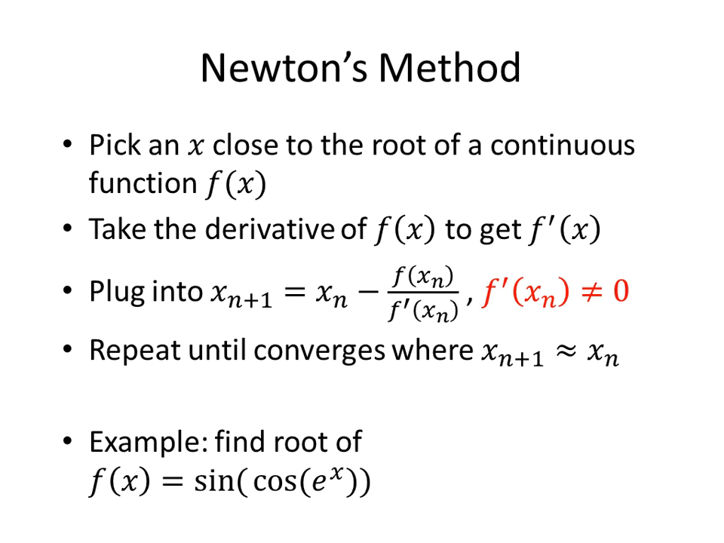

Slide 3
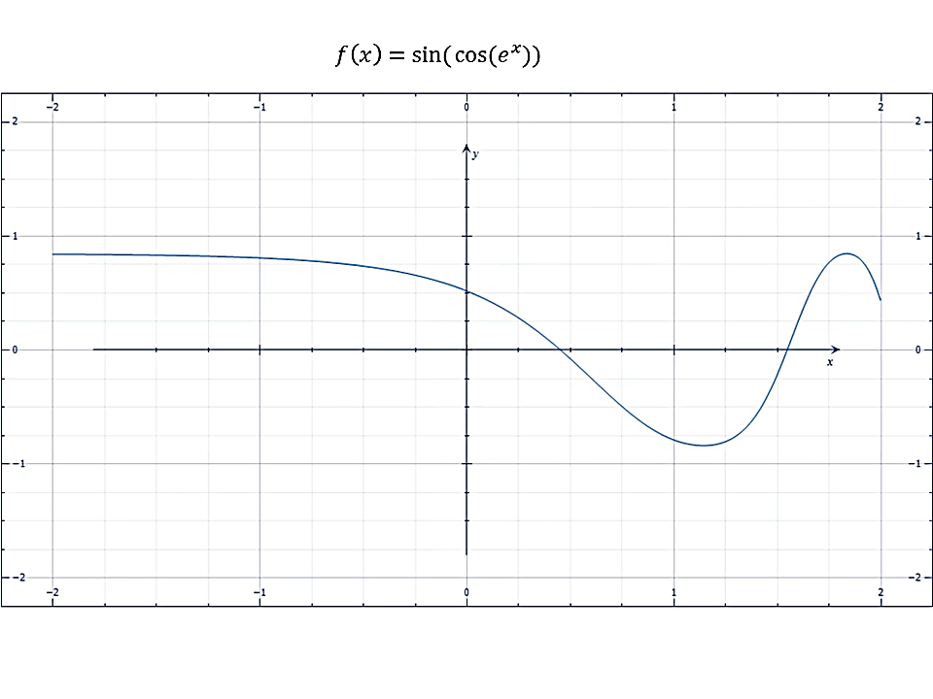

Slide 4
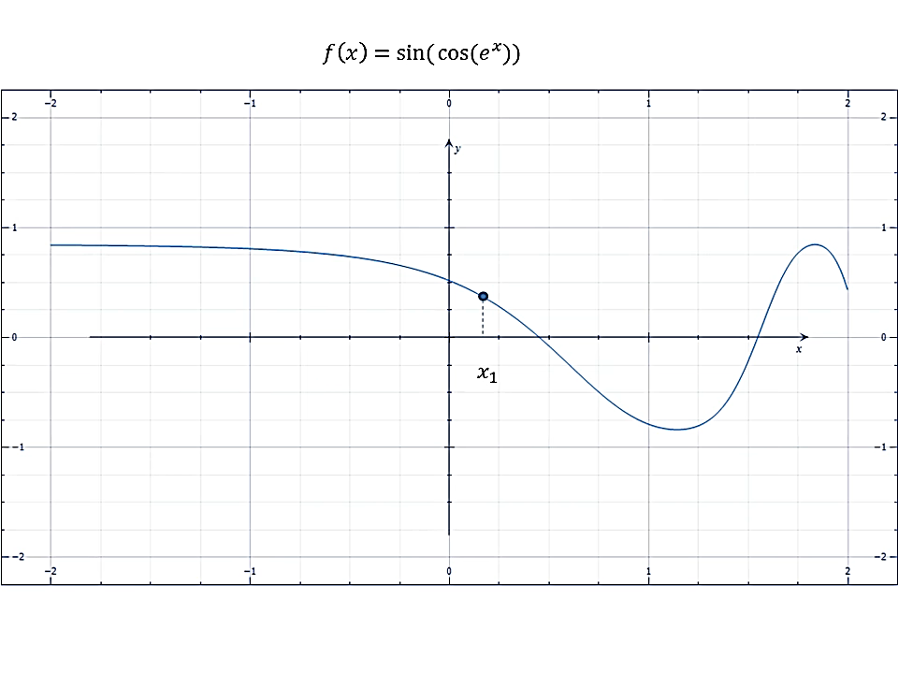

Slide 5
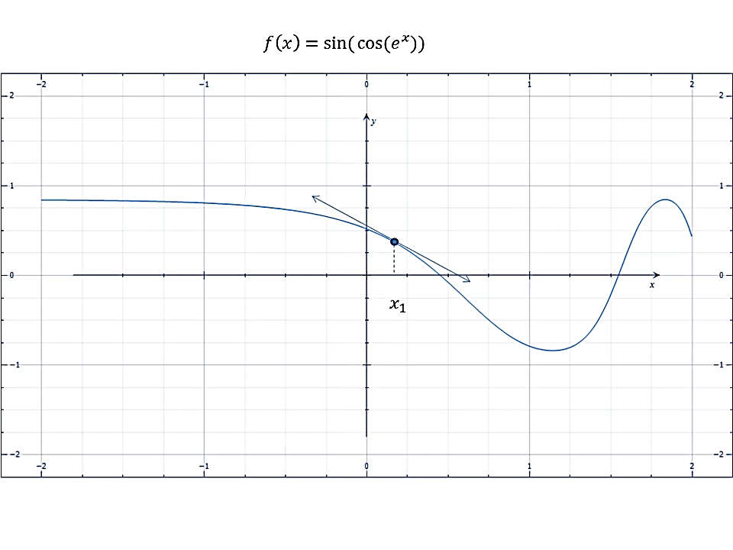

Slide 6
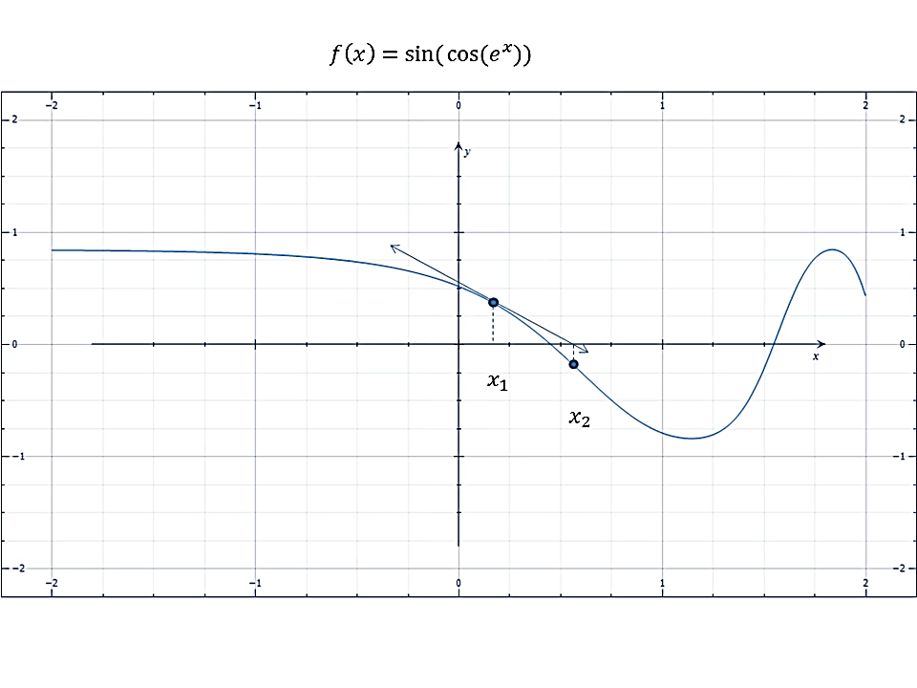

Slide 7
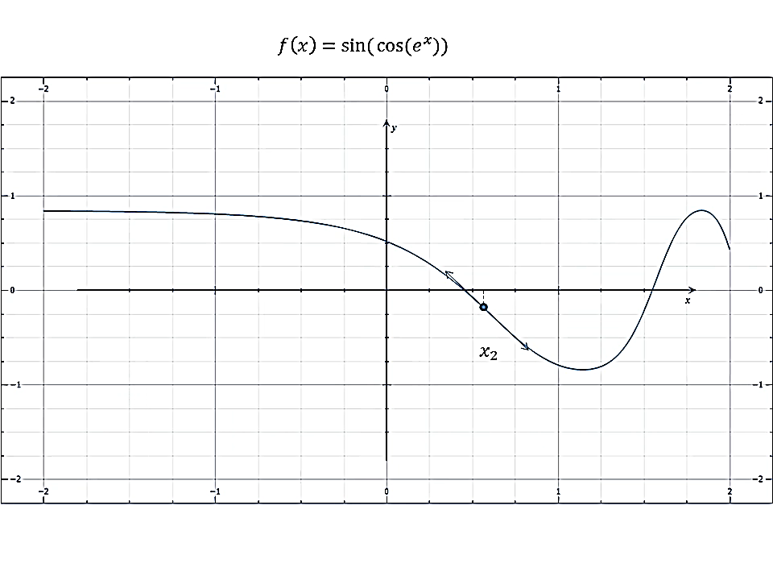

Slide 8
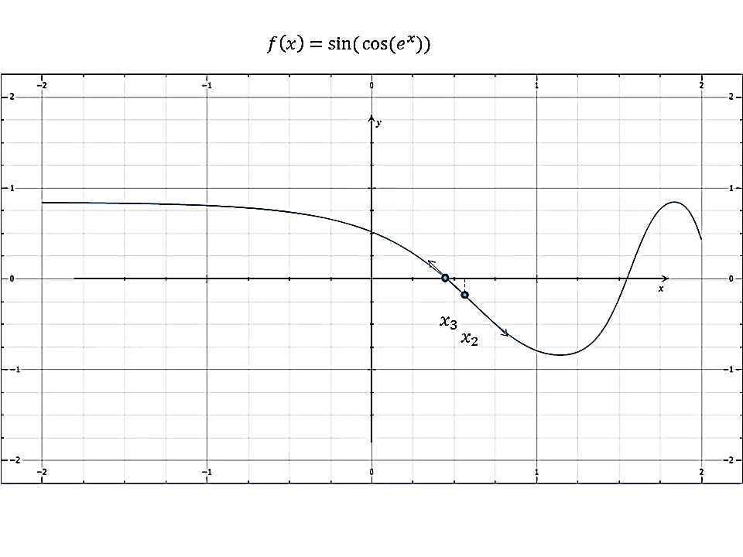

Slide 9
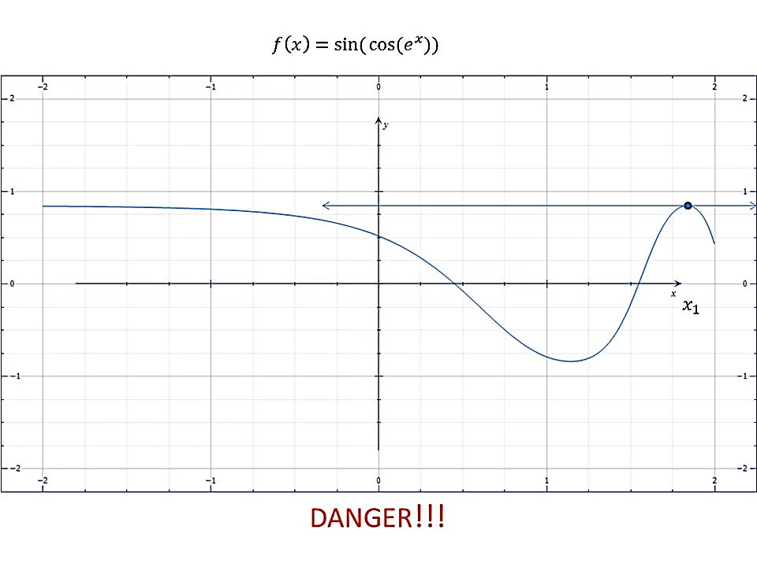

Slide 12
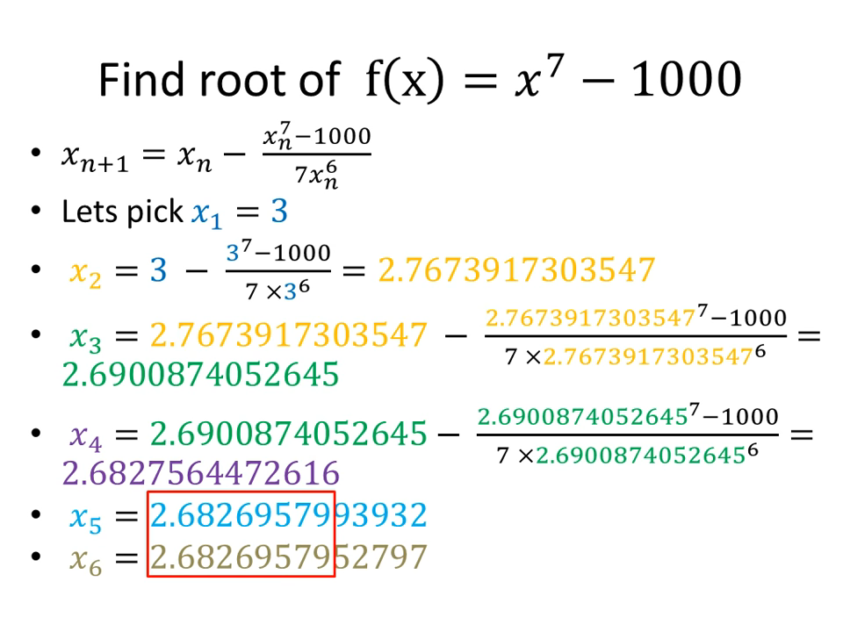

Slide 13
Summery
Thus, the approach rapidly converges on the true root. Notice that the true percent relative error at each iteration decreases much faster than it does in simple fixed-point iteration.

