Slide 1
Numerical Computation and Optimization
Solution of Nonlinear Equations
Roots of Polynomials
Muller's Method
By
Assist Prof. Dr. Ahmed Jabbar

Slide 3
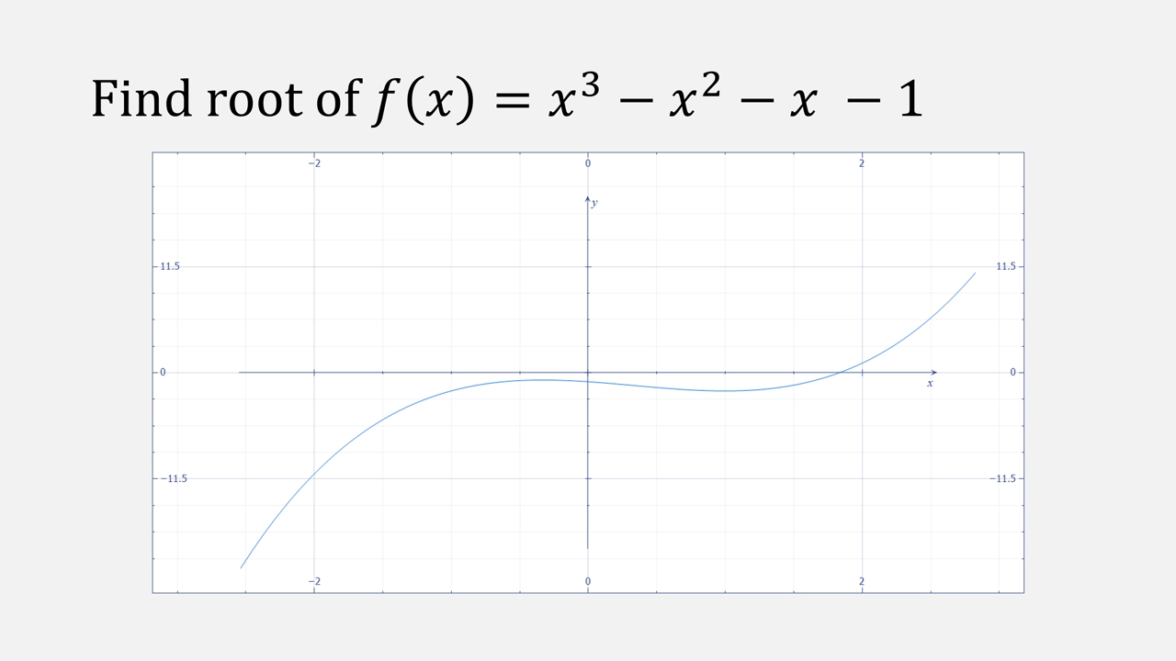

Slide 4
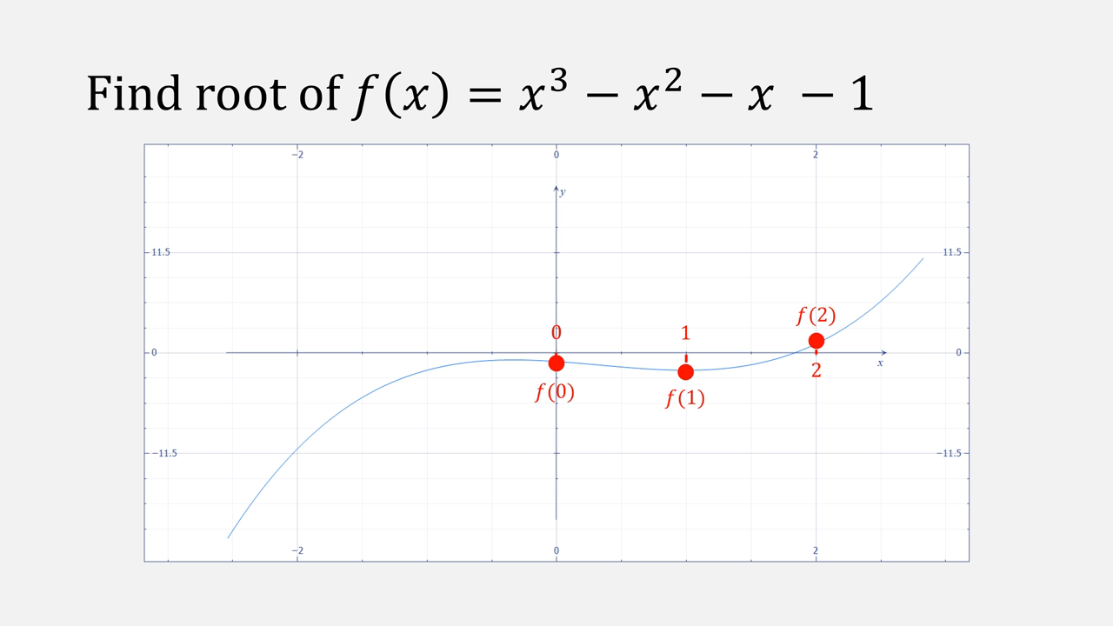

Slide 7
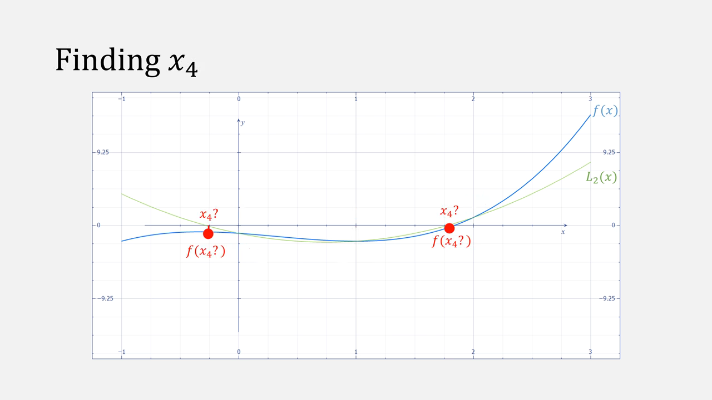

Slide 9
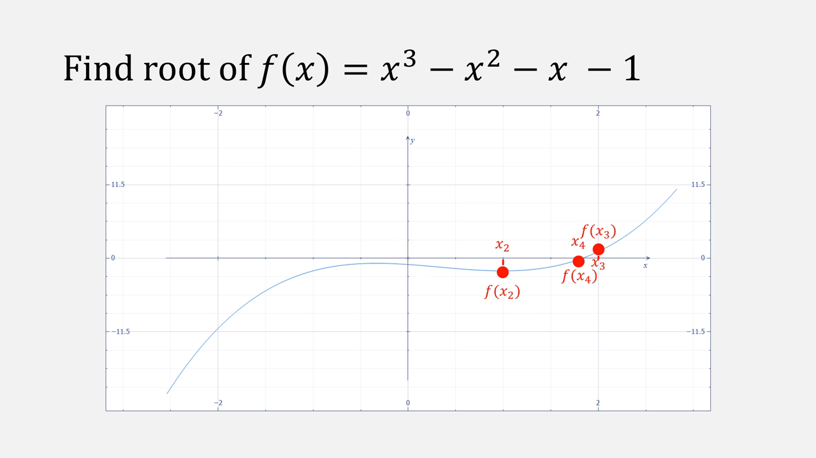

Slide 10
