Slide 1
Numerical Computation and Optimization
Numerical Optimization
Golden-section Search
By
Assist Prof. Dr. Ahmed Jabbar

Slide 2
One-Dimensional Unconstrained Optimization
This section will describe techniques to find the minimum or maximum of a function of a single variable, f (x). A useful image in this regard is the one-dimensional, “roller coaster”. Recall from Part Two that root location was complicated by the fact that several roots can occur for a single function. Similarly, both local and global optima can occur in optimization. Such cases are called multimodal.
In almost all instances, we will be interested in finding the absolute highest or lowest value of a function.
Thus, we must take care that we do not mistake a local result for the global optimum.

Slide 8
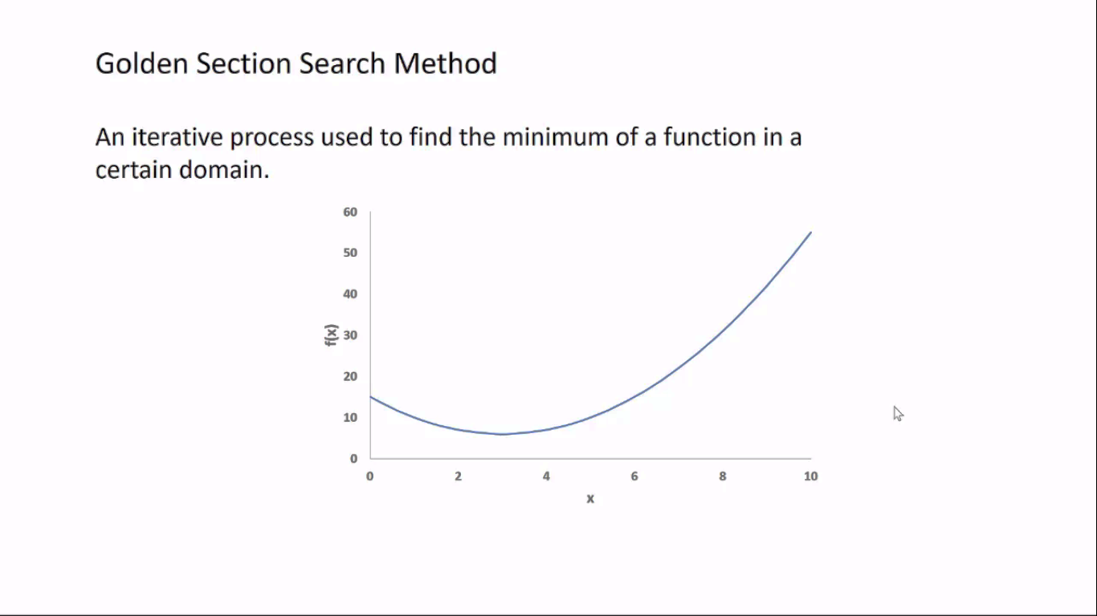

Slide 9
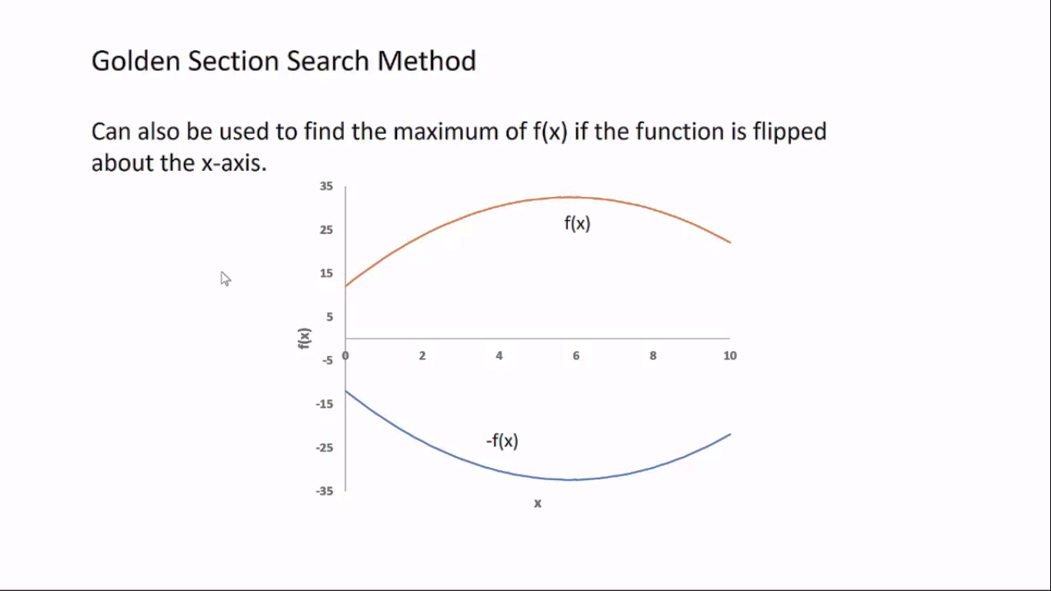

Slide 10
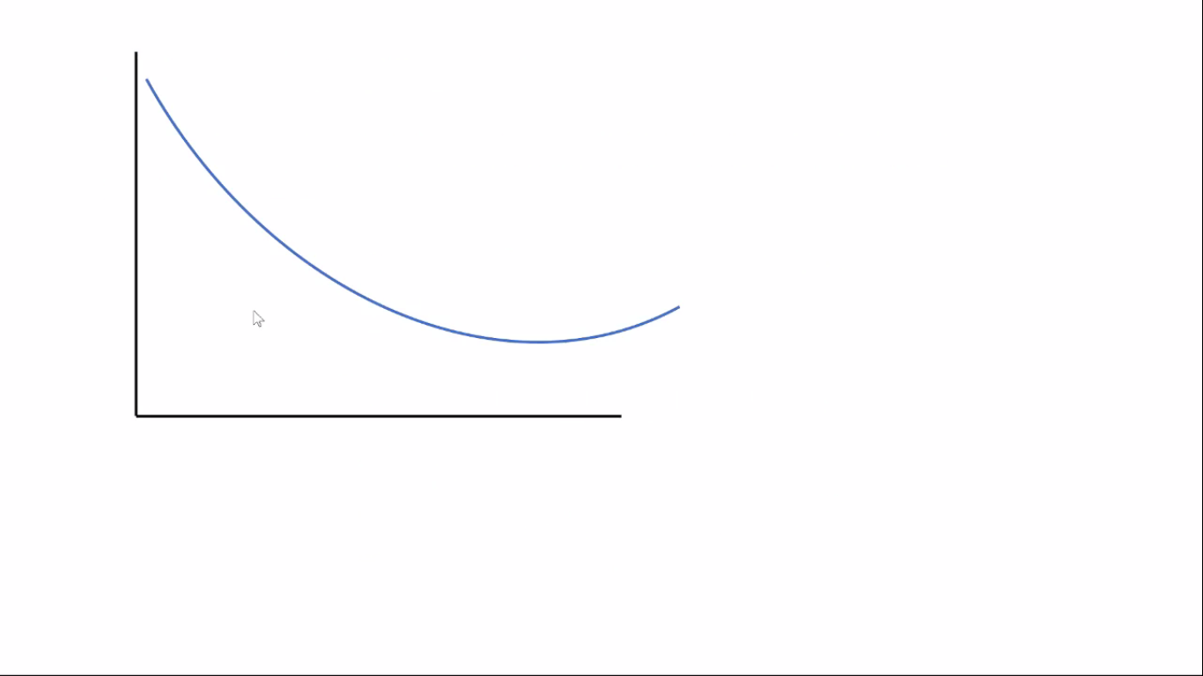

Slide 11
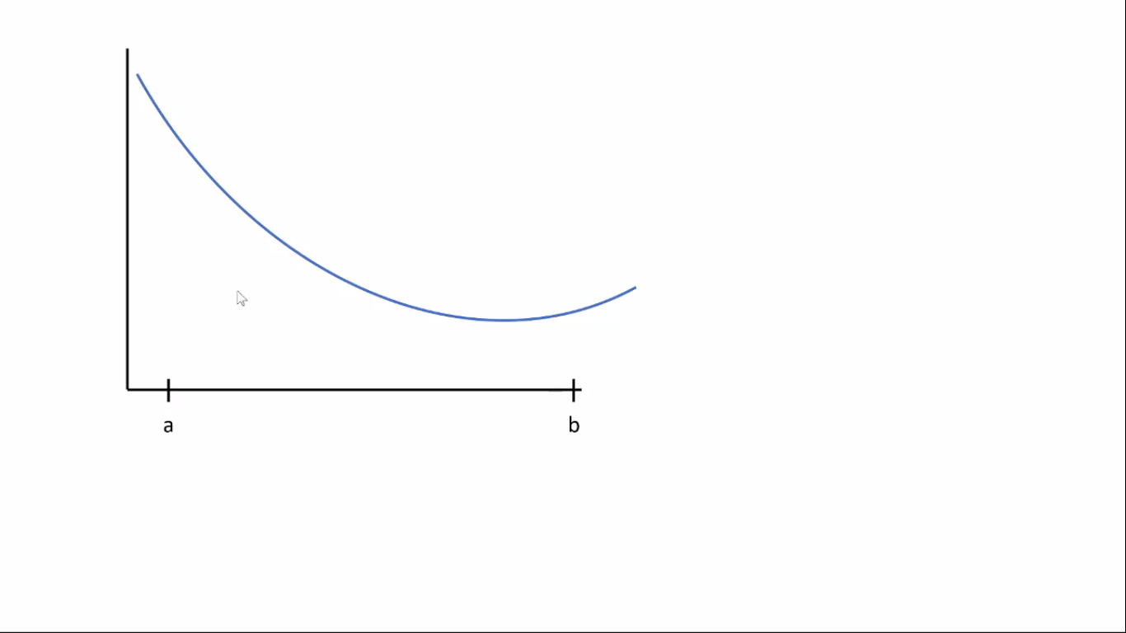

Slide 12
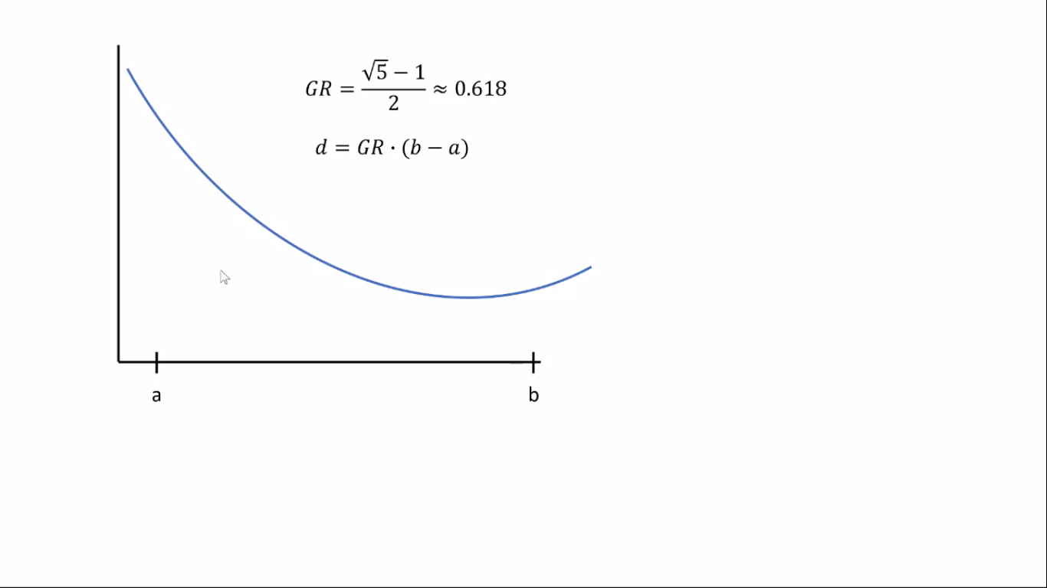

Slide 13
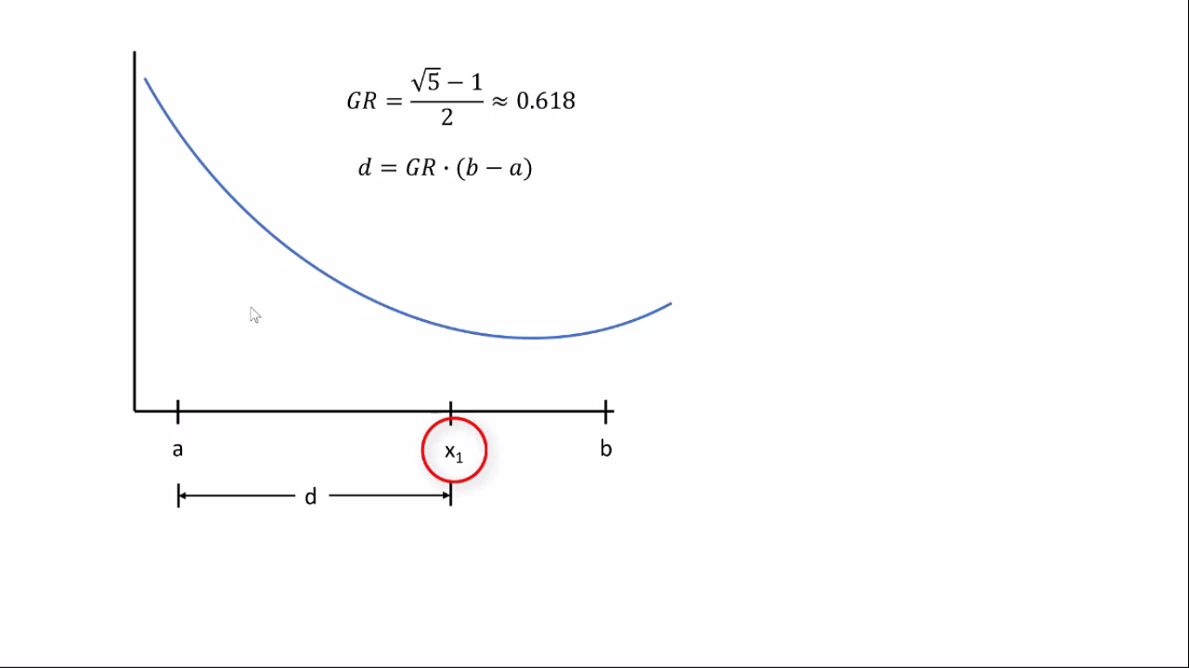

Slide 14
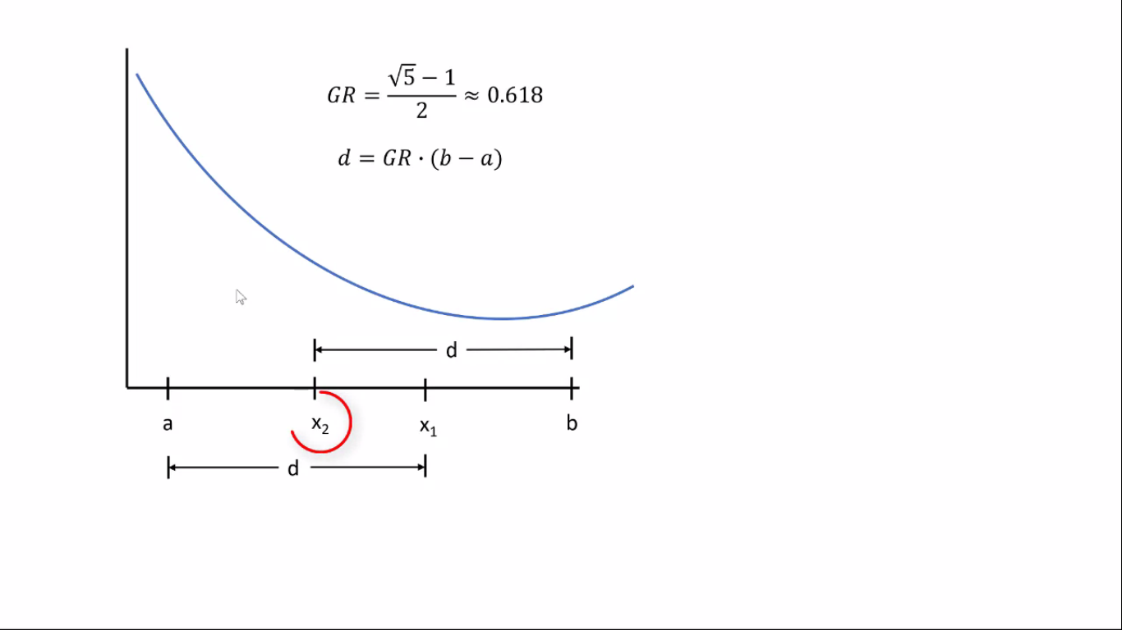

Slide 15
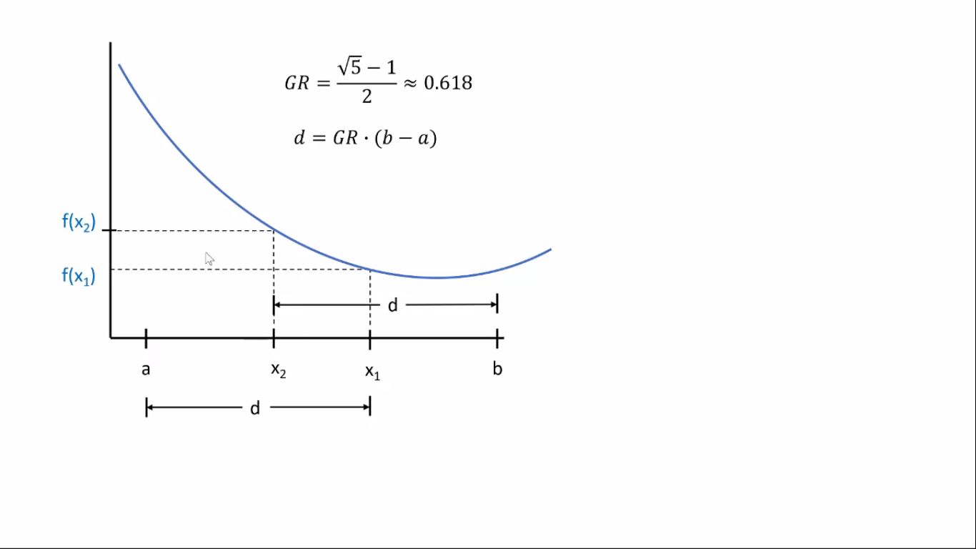

Slide 16
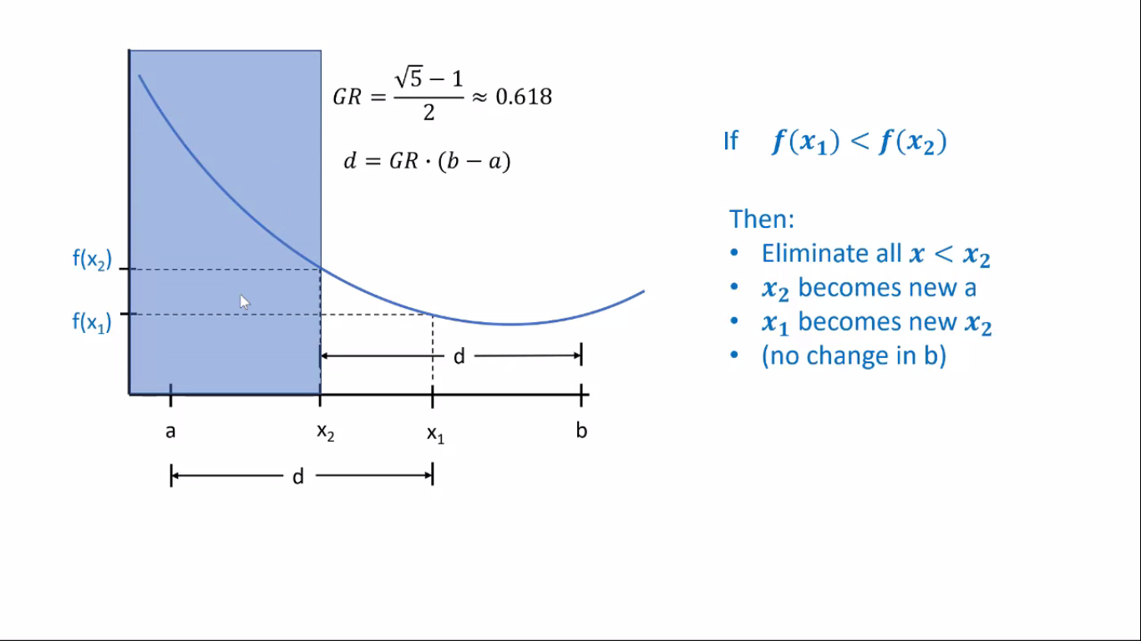

Slide 17
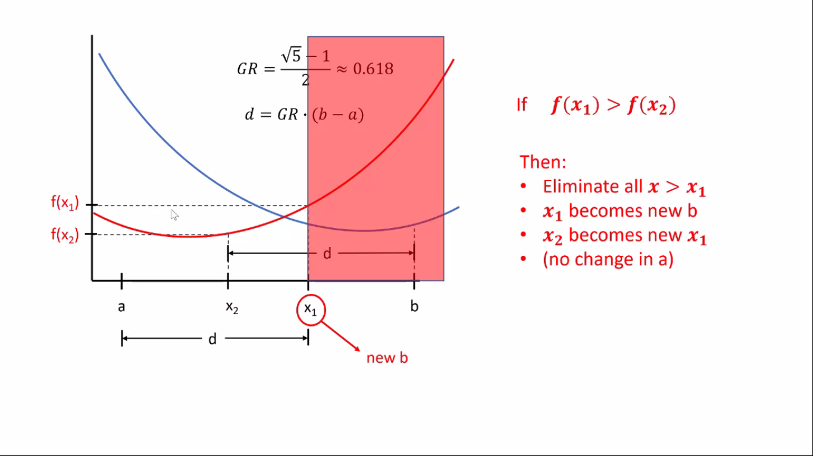

Slide 18
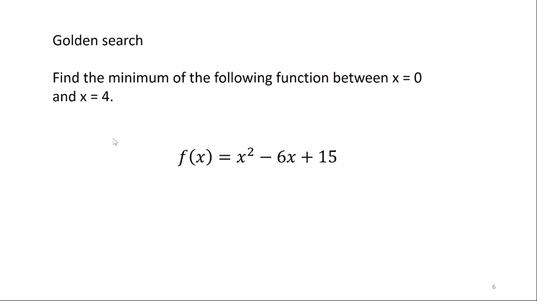
10.

Slide 19
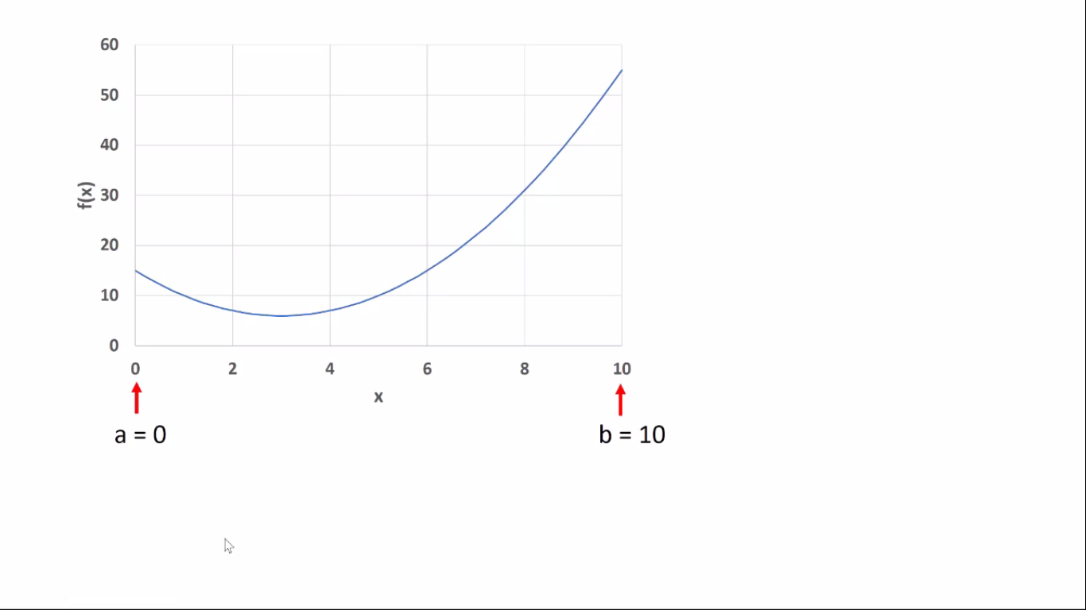

Slide 20
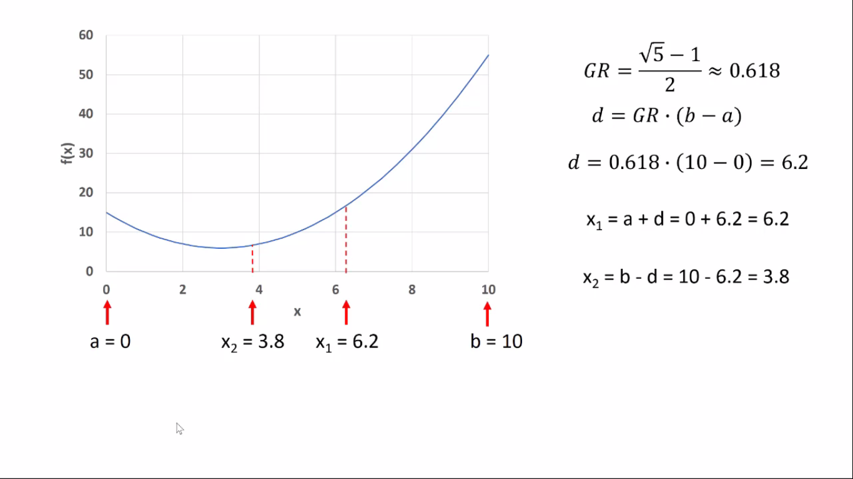

Slide 21
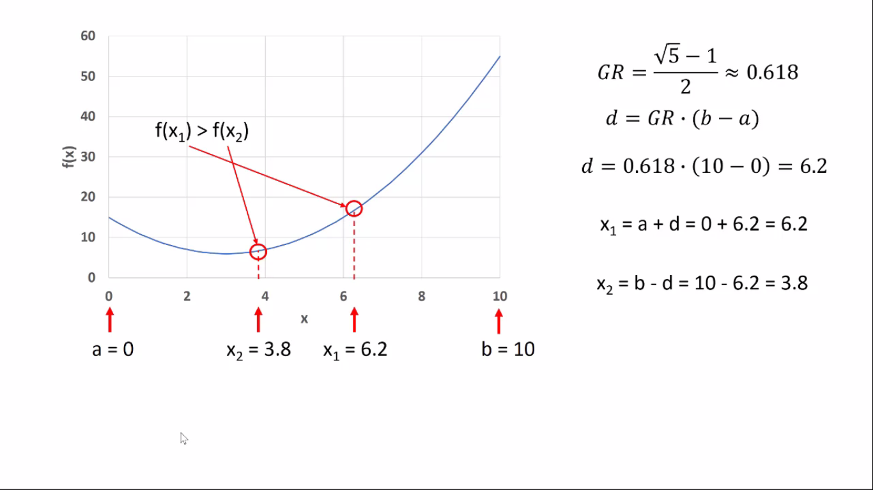

Slide 22
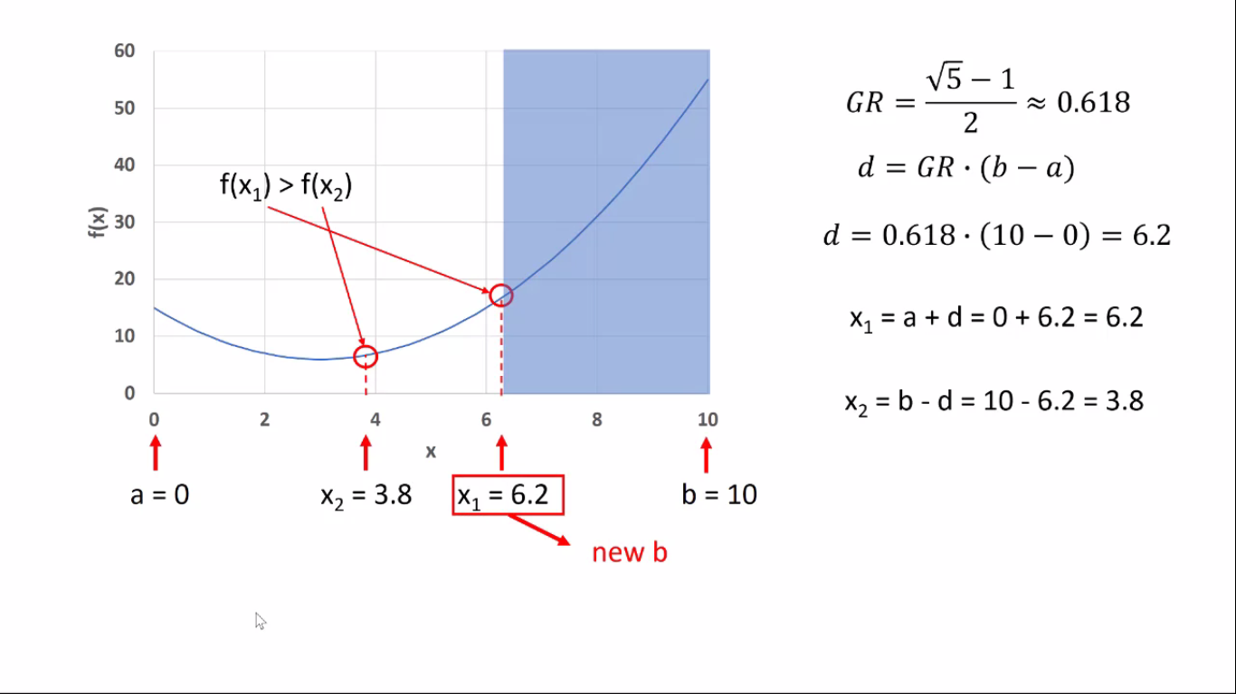

Slide 23
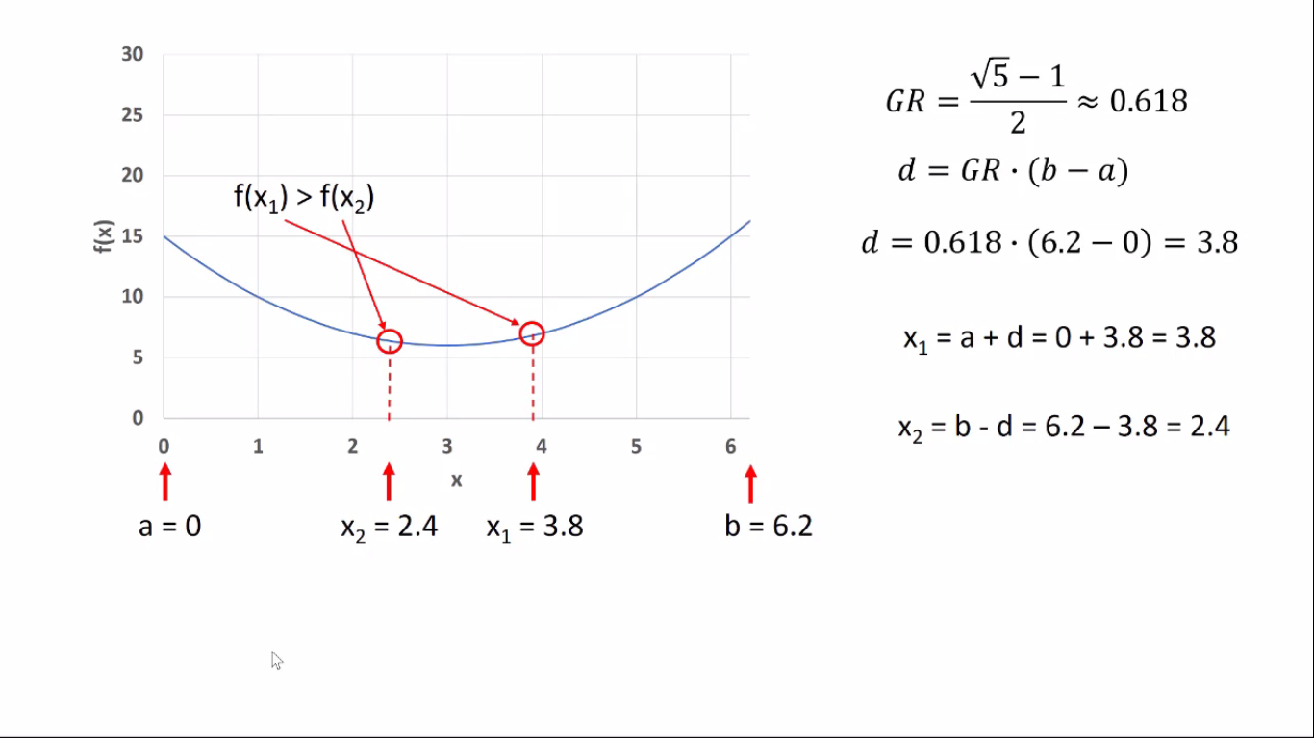

Slide 24
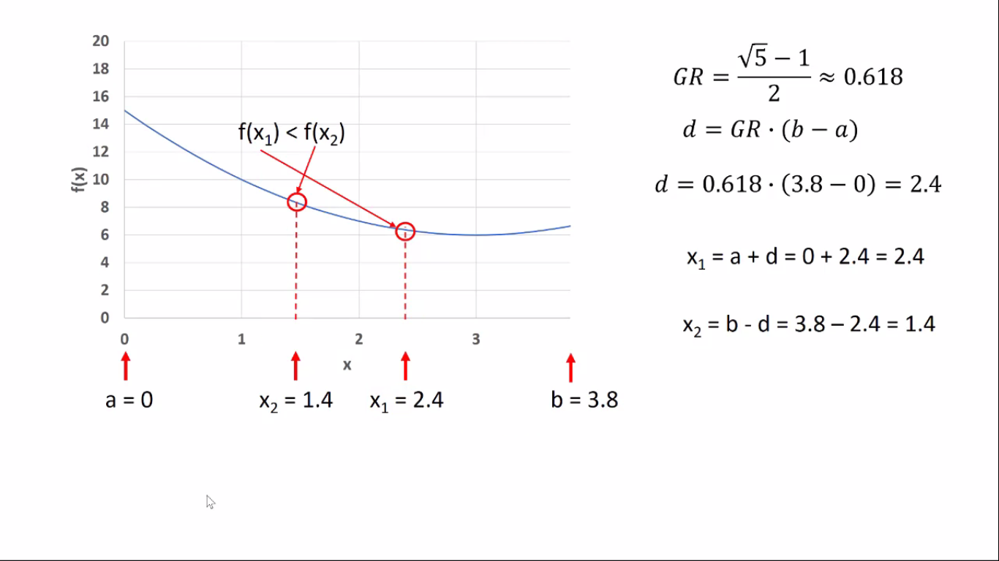

Slide 25
