Slide 1
Numerical Computation and Optimization
Solution of Nonlinear Equations
Open Methods
Bisection Method
By
Assist Prof. Dr. Ahmed Jabbar

Slide 2
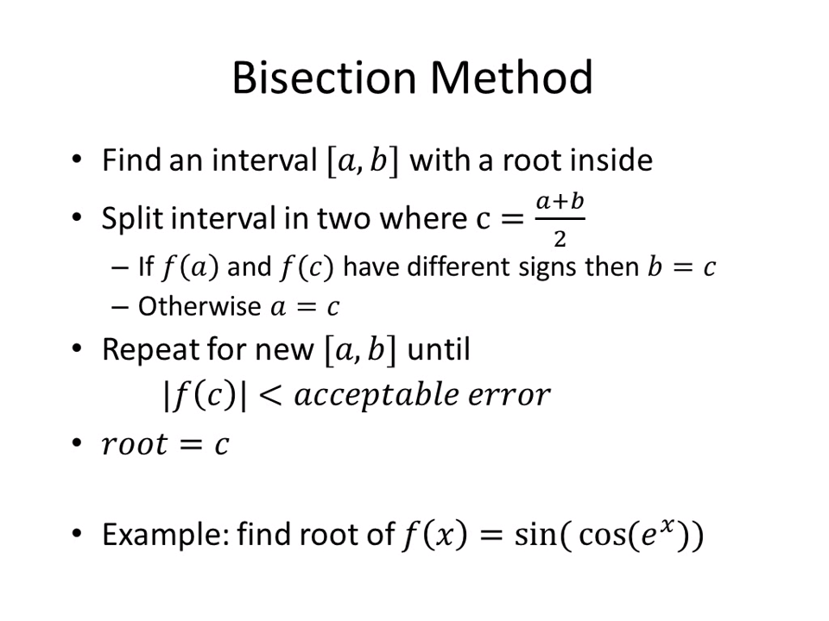

Slide 3
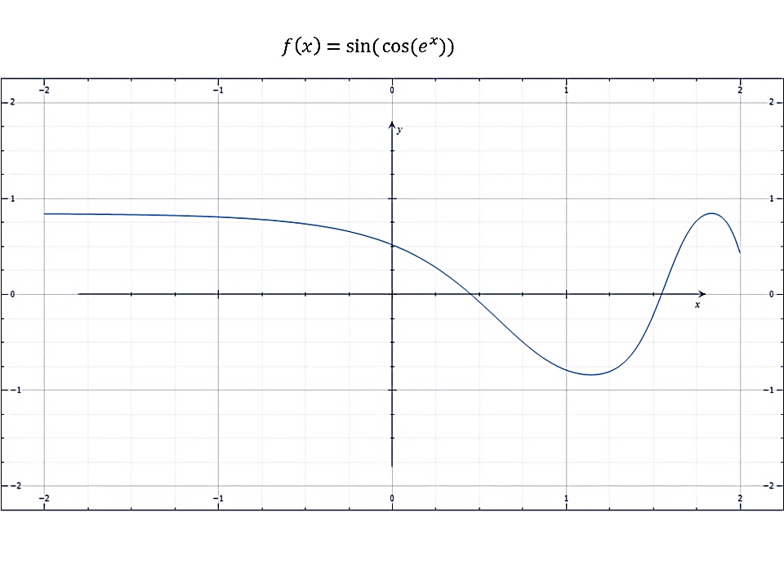

Slide 4
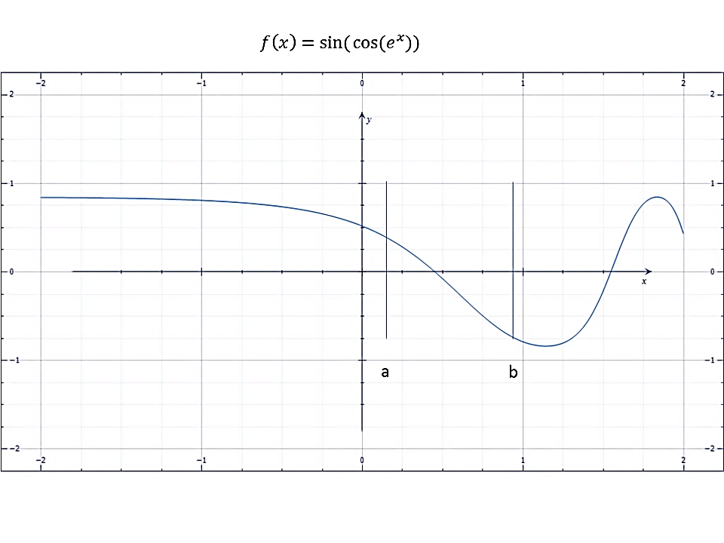

Slide 5
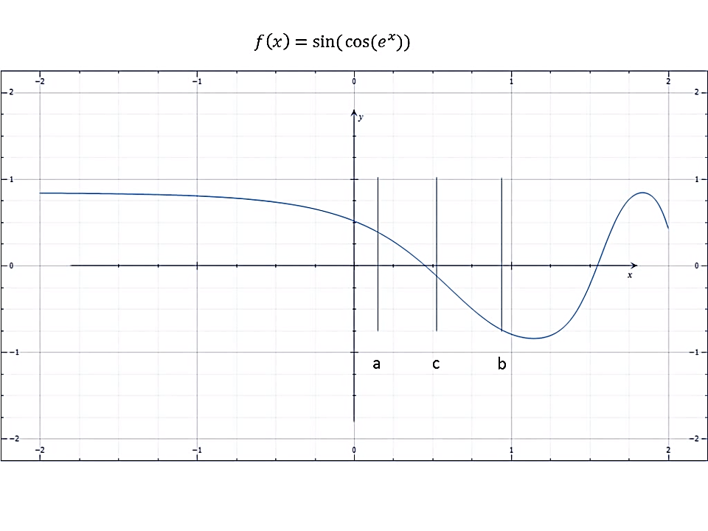

Slide 6
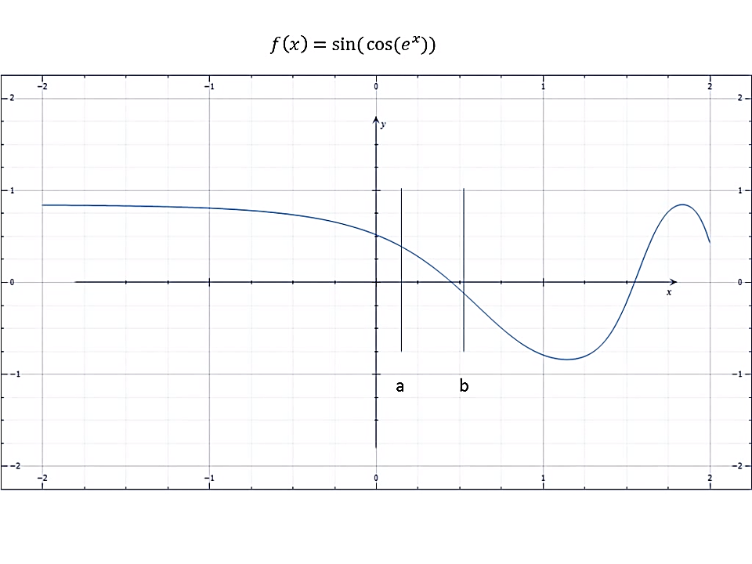

Slide 7
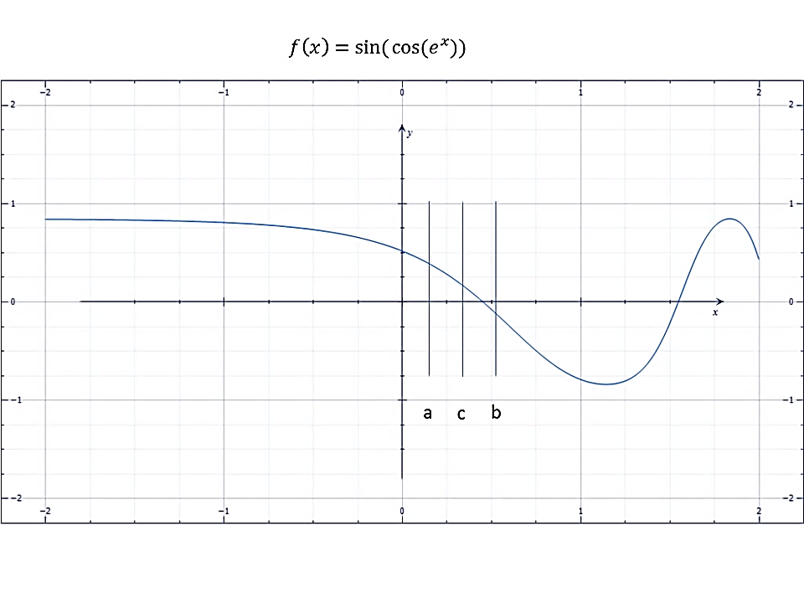

Slide 8
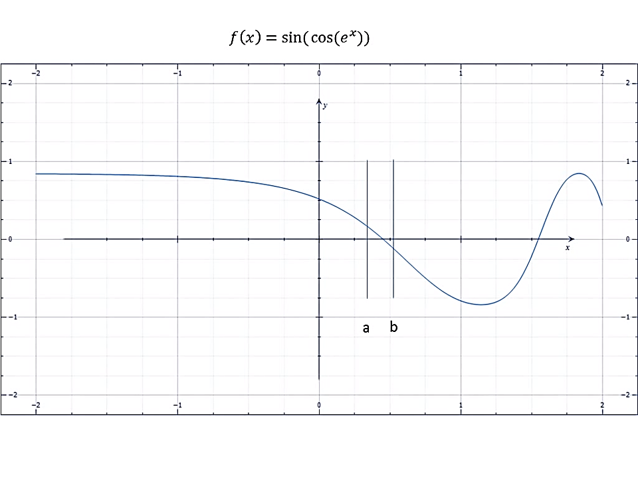

Slide 9
BISECTION

Slide 10
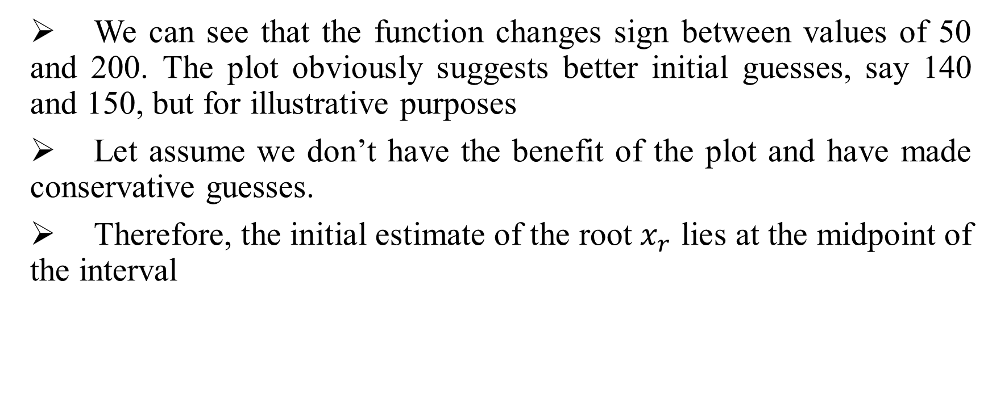
Example:
We can see that the function changes sign between values of 50 and 200. The plot obviously suggests better initial guesses, say 140 and 150, but for illustrative purposes
Let assume we don’t have the benefit of the plot and have made conservative guesses.
Therefore, the initial estimate of the root$x_{r}$ lies at the midpoint of the interval

Slide 11
Example:

Slide 12
Example:

Slide 13
Error Estimates for Bisection
Approximate percent relative error
True percent relative error

Slide 14
Error Estimates for Bisection
Problem Statement. Continue Example until the approximate error falls below a stopping criterion of εs = 0.5%. Use Eq. (5.5) to compute the errors.

